Slide 1


Low Power Variation-Aware Cores based on Dynamic Data-Dependent Bitwidth Truncation
Ioannis Tsiokanos, Lev Mukhanov, Georgios Karakonstantis
ECIT Institute, Queen’s University Belfast
This work is partially supported by the European projects
UniServer (grant no. 688540 ) and OPRECOMP (grant no. 732631)

Slide 2
Outline
Introduction & Motivation
Proposed approach & Design flow
Case study: application to an FPU
Experimental results
Conclusions

Slide 3
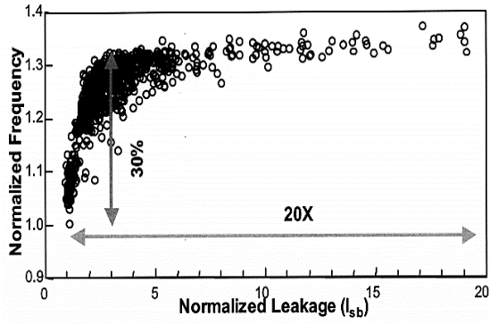
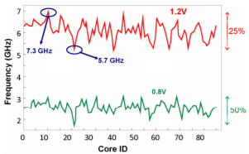


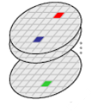
Challenge: Variations in Nanoscale Era
Transistor shrinking has made circuits more prone to static and dynamic variations
Up-to 50% delay variations
Such delay variations threaten correct functionality and ultimately yield
#of chips
F_{req1}
F_{req2}
F_{reqk}
< <
Frequency

Slide 4
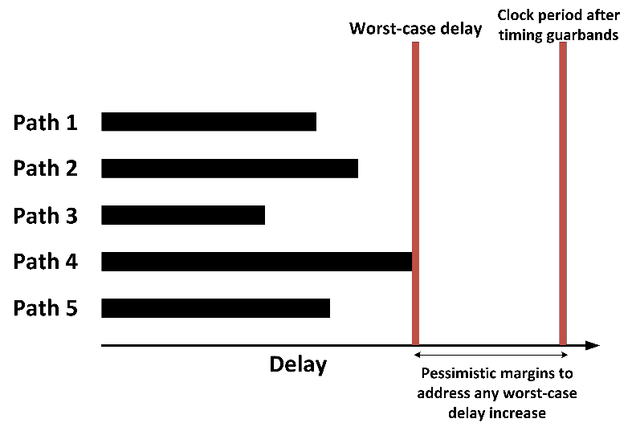
Conventional Variation-Aware Scheme
Designers address variations/failures by:
Using pessimistic timing/voltage guardbands
Based on Static Timing Analysis
Large power/performance overheads

Slide 5

Approximations & Variation-Aware Designs
Approximate Computing
Exploit error resilient properties of applications by:
Scaling precision
Truncating the bitwidth of operands
Reduce computational delay
Operand : 01010101010011101010101010111011
Operand after 10 LSBs truncation : 01010101010011101010100000000000
✗ Agnostic of the underlying hardware
✗ Application to simple arithmetic units
✗ Static approximation of all data
✗ Unnecessary quality loss

Slide 6
Proposed Approach
Target:
Introduce an occasional dynamic bitwidth truncation to avoid timing failures in pipelined designs
Methods:
Dynamic prediction of the error-prone Long Latency Paths (LLPs)
Identify instructions and operands that activate LLPs at runtime
Path Shaping
Isolate the LLPs to a single pipeline stage
Operand bitwidth truncation
Truncating the bit-width only of the few operands that activate the LLPs

Slide 7
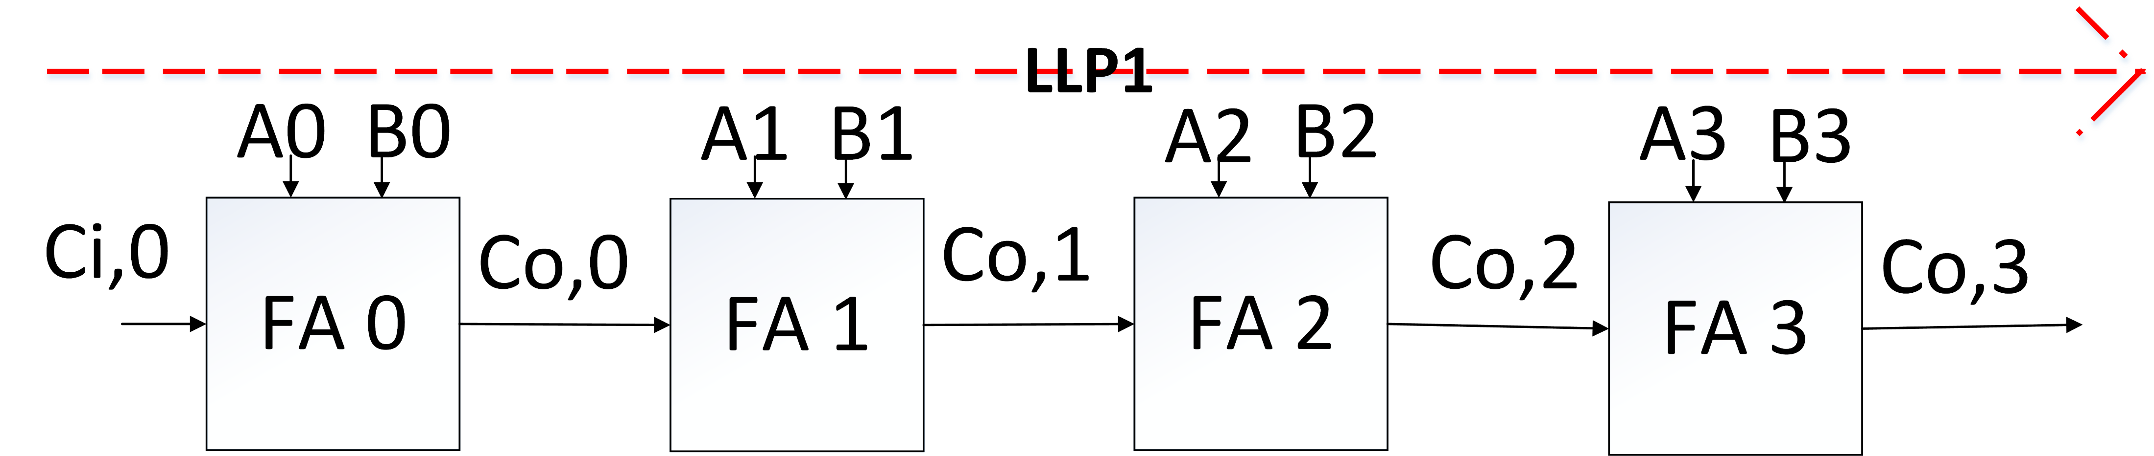
Method (I) – Dynamic Prediction of LLPs
Identify in advance operands that activate the error-prone LLPs
Ripple carry adder example
Most timing critical path (LLP1): Carry propagation from Ci,0 to Co,3
Identify LLPs activation by monitoring Carry propagation at FA0 & FA1:
SLP1
SLP2
F(0,1) = (A0⊕B0)•(A1⊕B1)
F(0,1) =1 Activation of Long Latency Paths (LLPS)
F(0,1) =0 Activation of Short Latency Paths (SLPs)

Slide 8
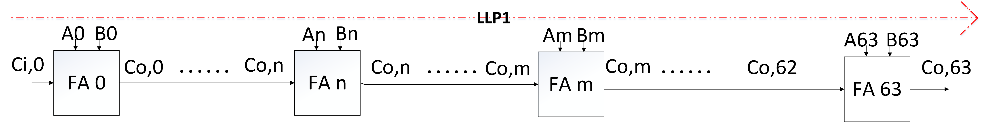
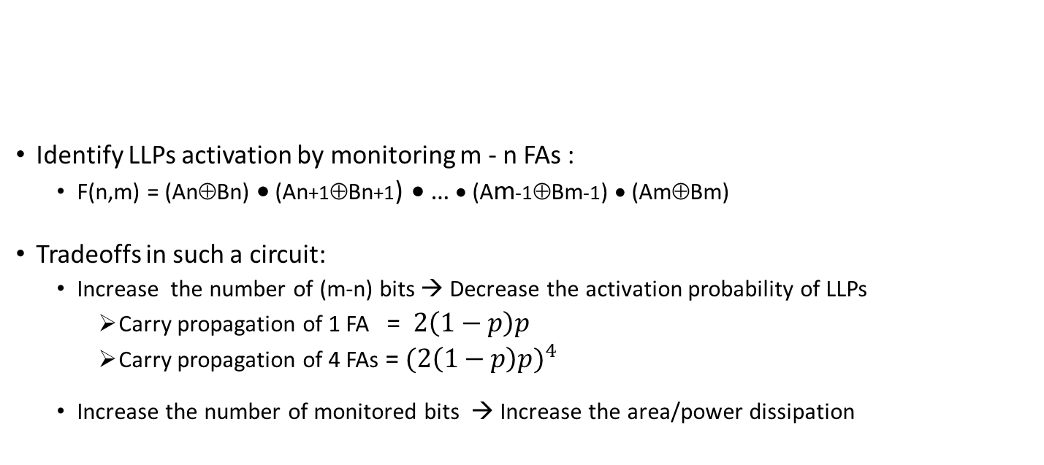
Method (I) – Dynamic Prediction of LLPs
Identify LLPs activation by monitoring m - n FAs :
F(n,m) = (An⊕Bn) • (An+1⊕Bn+1) • … • (Am-1⊕Bm-1) • (Am⊕Bm)
Tradeoffs in such a circuit:
Increase the number of (m-n) bits → Decrease the activation probability of LLPs
Carry propagation of 1 FA = $2\left(1−p\right)p$
Carry propagation of 4 FAs = ${(2\left(1−p\right)p)}^{4}$
Increase the number of monitored bits → Increase the area/power dissipation
SLP1
SLP2
Application of such a unit to pipelined designs is not so straightforward

Slide 9
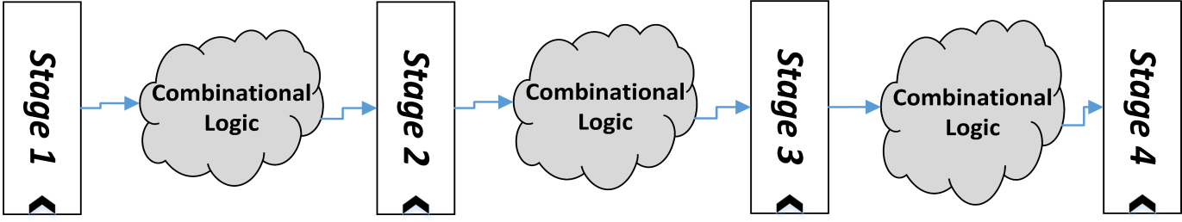
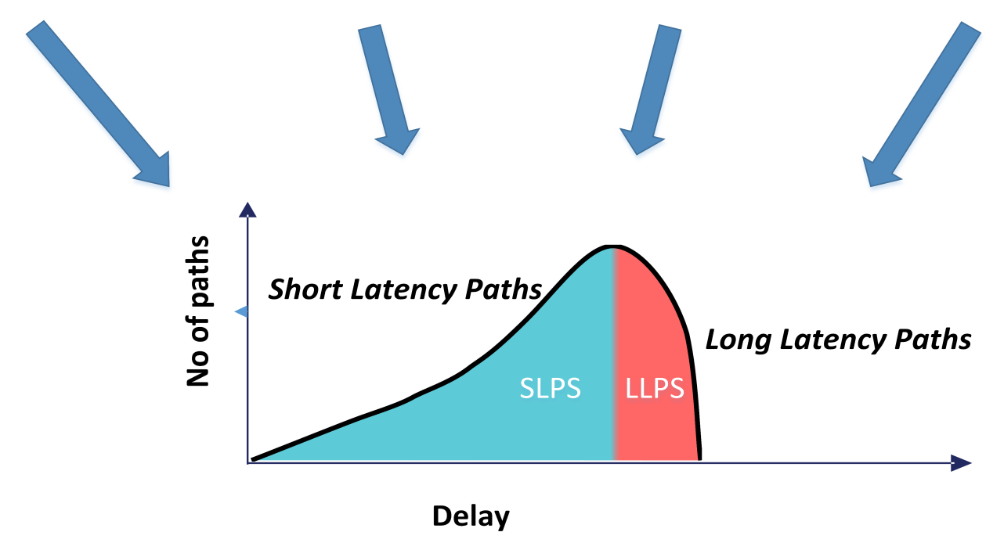
Method (II) – Path Shaping
Performance-centric ASIC flow
Primary objective: improvement of performance
The inherently fast paths are allowed to become slow
Many long paths from every stage are close to target clock period
Timing wall
Increased probability of failures
Use of any error prediction/avoidance scheme in many stages
Timing Wall
Clock period
There is a need to move away from such a path distribution

Slide 10
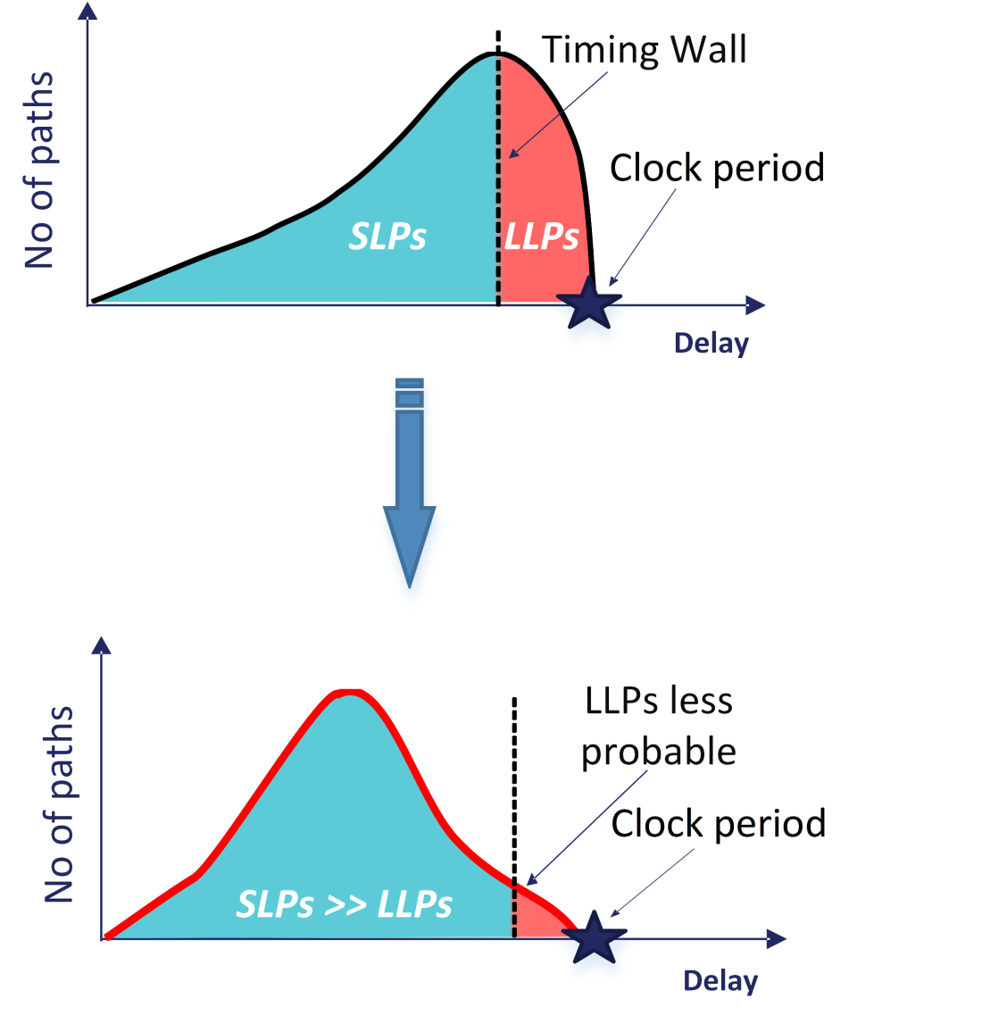
Method (II) – Path Shaping
Eliminate the timing wall
Enforce a path distribution with gradual slope, where |SLPs| >> |LLPs|
Render the LLPs less probable
Restrict the LLPs to single pipelined stage, accessed by specific instructions

Slide 11
Method (III) – Operand Truncation
Dynamically setting to 0 only the LSBs of the operands of the specific instruction(s) that activate the LLPs
Addition of two 8 bits operands
A: 00000001 and B: 01111111
00000001
+ 11111111
110000000
Addition of two operands after 4 LSBs truncation
A: 00000000 and B: 01110000
00000000
+ 11110000
11110000
No truncation
4 LSBs truncation
Carry propagation,
Activation of LLPs
No Carry propagation,
Activation of SLPs
Any quality loss can be controlled by selecting the proper number of truncated bits

Slide 12
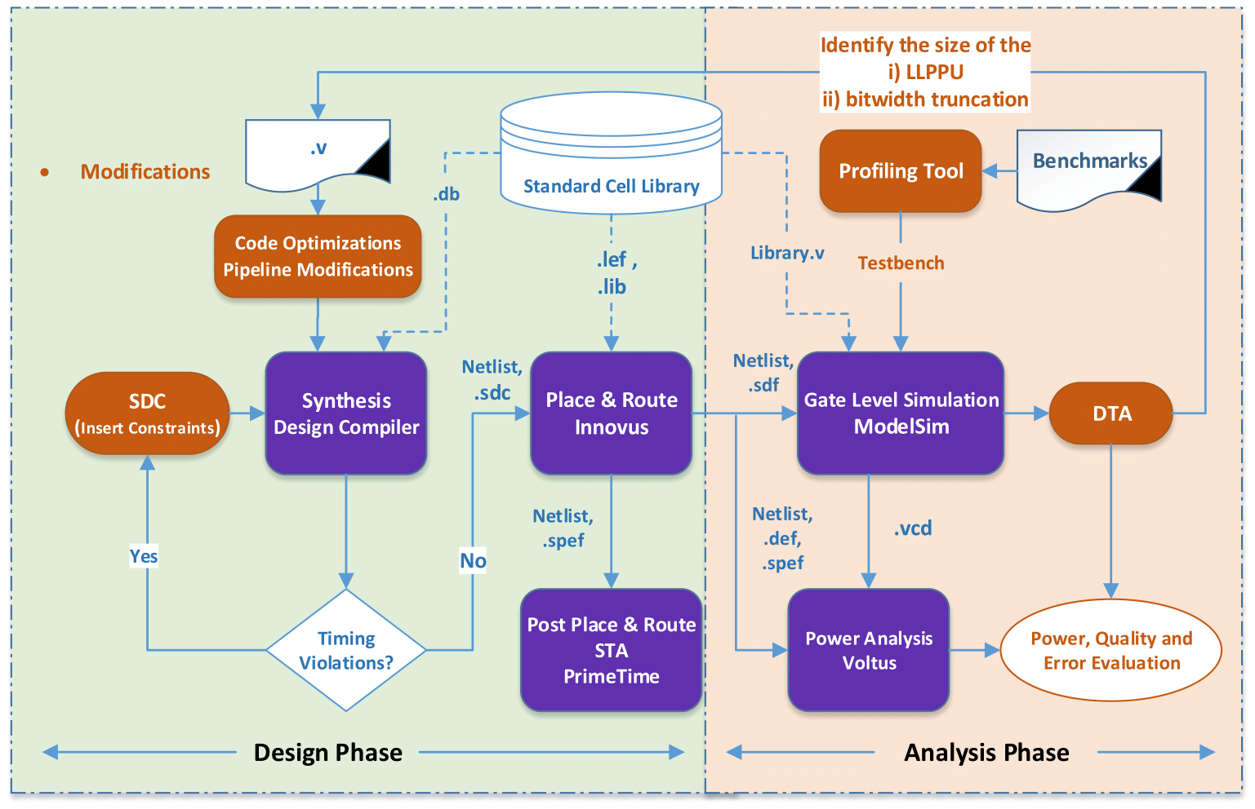
Proposed Design & Analysis Flow
Microarchitectural and Code optimizations
Extra optimization step
A profiling tool for extracting instruction traces and operands as are being executed on real processors
Exploit the dynamic data-dependent path activation
Simulate the design under potential timing variations
Power, quality, error and dynamic power measurements
Introduction of path-group constraints
Make long paths smaller in number
Not allow the tool to make the naturally fast paths slower

Slide 13
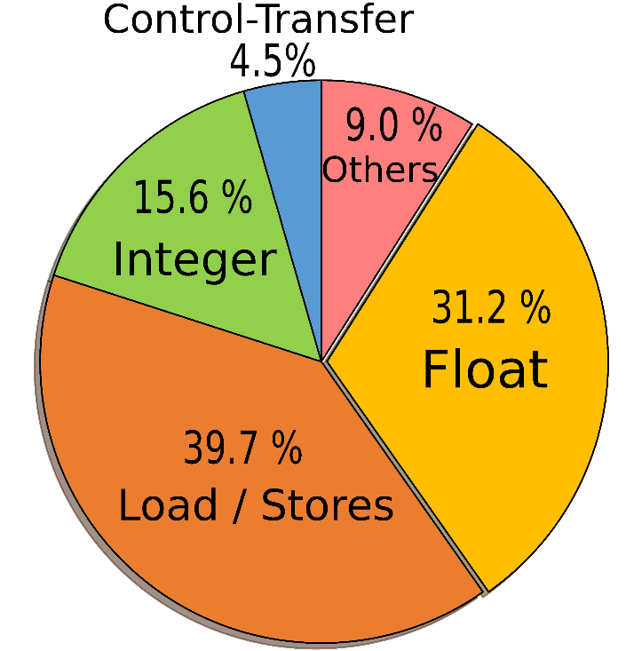
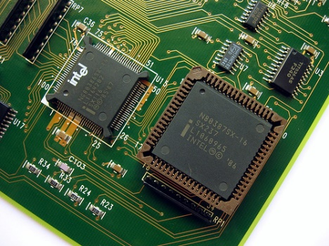
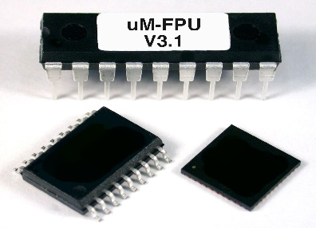
Case study: Application to an FPU
Application to the mor1kx marocchino pipeline double precision FPU based on OpenRISC Instruction Set Architecture
Targeted FPU consists of 6 pipeline stage
Excellent representatives of complex pipelined designs
Floating point operations dominant in various apps
Considered apps:
K-means, CFD and Heartwall from Rodinia Suite,
Raytrace from Parsec Suite
Average instruction distribution

Slide 14
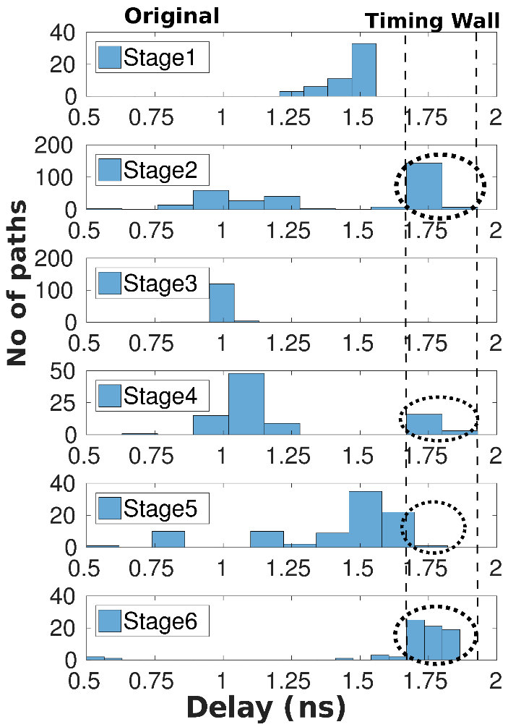
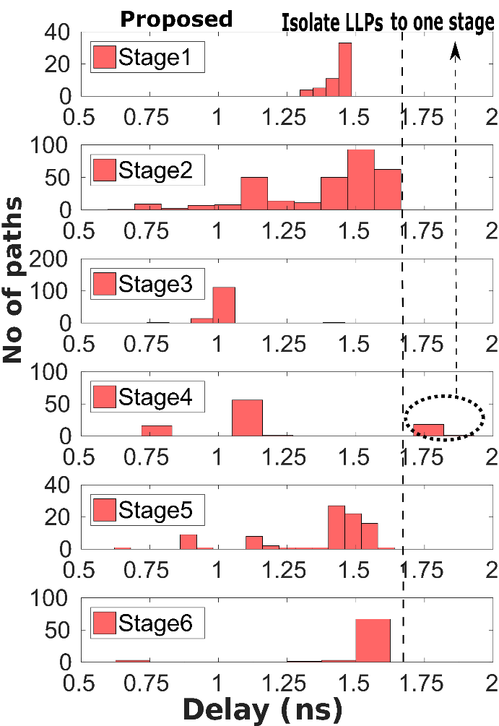
Path distribution of the Re-designed FPU
Original Design
Timing wall
LLPs in 4 out of 6 stages
Increase probability of failures
Proposed design
Number and probability of LLPs have been reduced
LLPs restricted only to Stage 4
Stage 4: mantissa addition

Slide 15
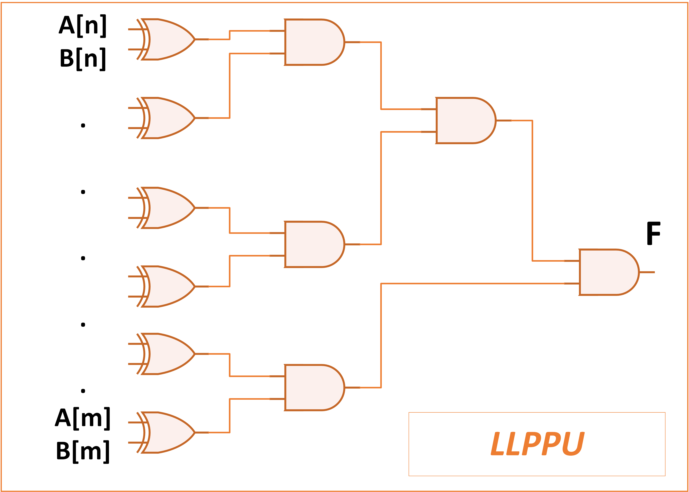
Long Latency Paths Prediction Unit (LLPPU)
Adoption of a prediction unit for detecting LLPs activation at Stage 4
Low complexity unit:
F(n,m) = (An⊕Bn) • … • (Am⊕Bm)
number of (m-n) bits
activation probability of LLPs (P(L))
(n,m) |  | (27 , 34) | (27 , 33) | (28 , 33) | (28 , 32)
P(L) (%) |  | 0.62 | 1.1 | 2.71 | 4.98

Slide 16
Evaluation Results
Application profiling
Use of a profiling tool to extract real floating-point traces
Simulation under potential worst-case delay increase levels
Different clock period reductions levels (from 0% up-to 11%)
Designs being compared:
Dynamic 40 LSBs truncation only of the operands that activate LLPs (Prop)
Original unmodified design (Orig)
Static 40 LSBs truncation of all the operands (Trunc)
Guardband based technique

Slide 17
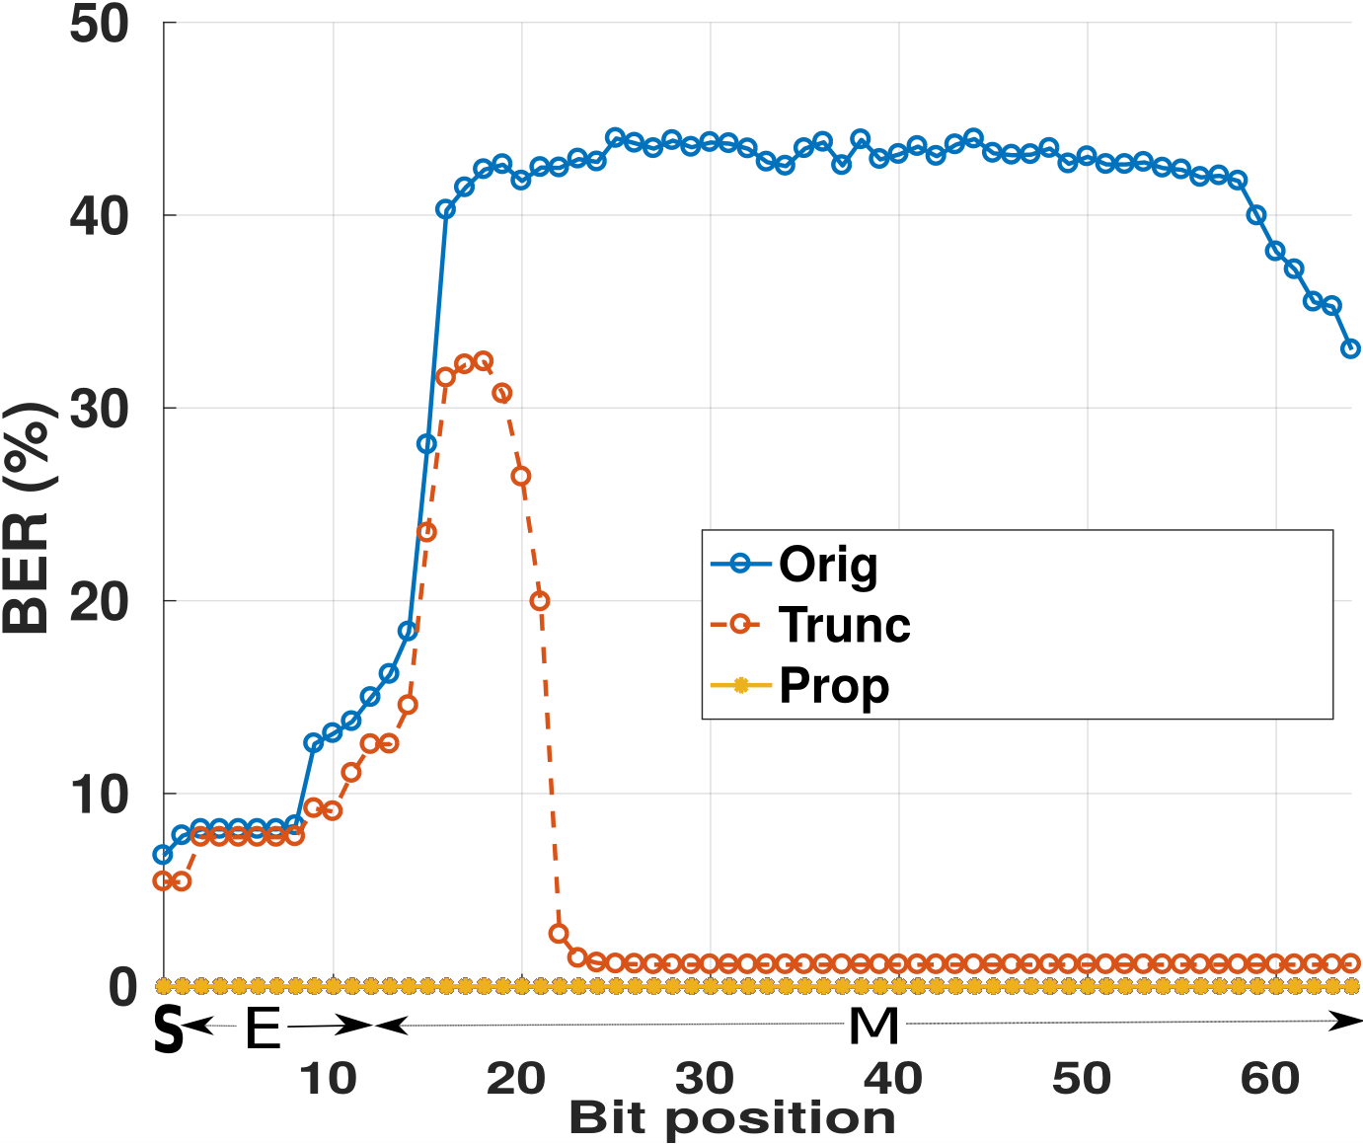
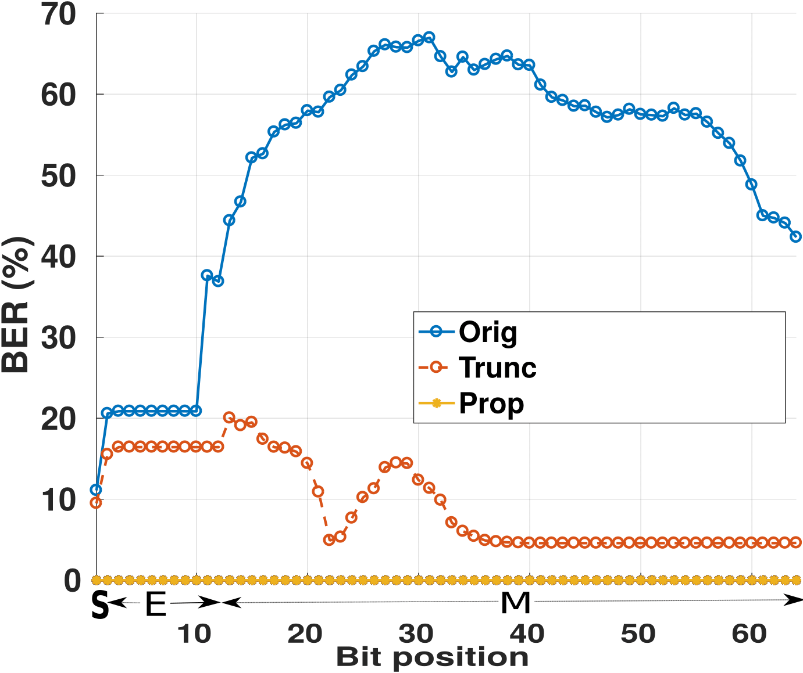
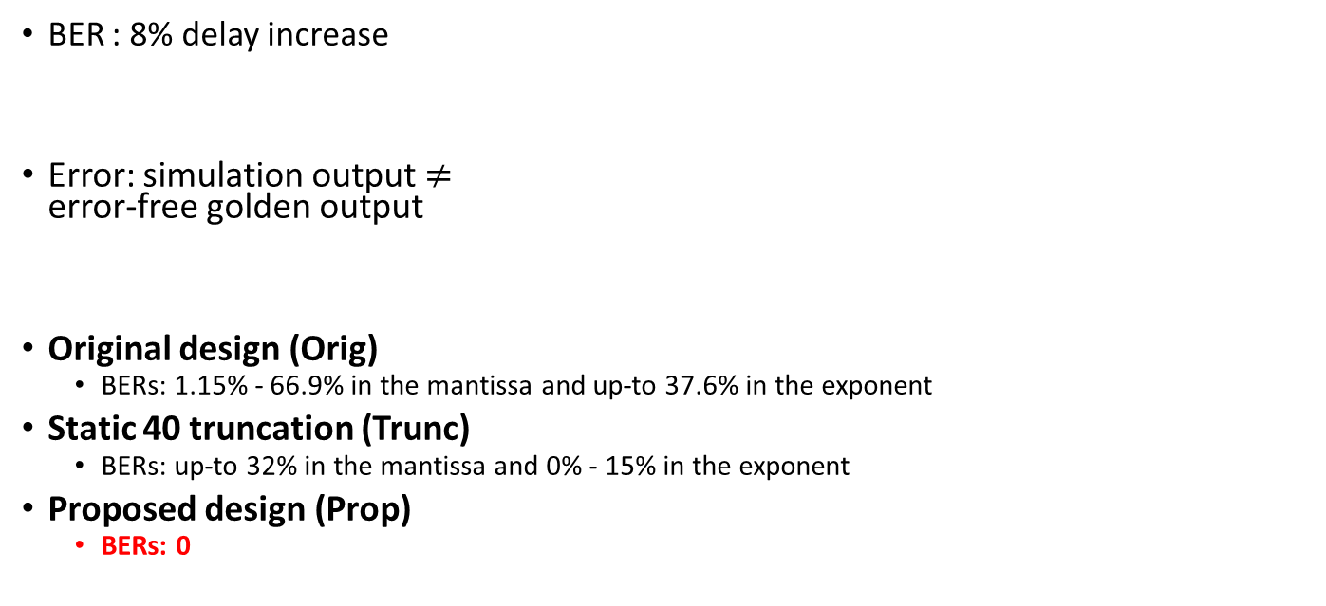
Evaluation Results – Bit Error Rate
CFD
Raytrace
BER : 8% delay increase
Error: simulation output $≠$ error-free golden output
Original design (Orig)
BERs: 1.15% - 66.9% in the mantissa and up-to 37.6% in the exponent
Static 40 truncation (Trunc)
BERs: up-to 32% in the mantissa and 0% - 15% in the exponent
Proposed design (Prop)
BERs: 0
Increased BERs in the mantissa and the exponent -> quality loss

Slide 18
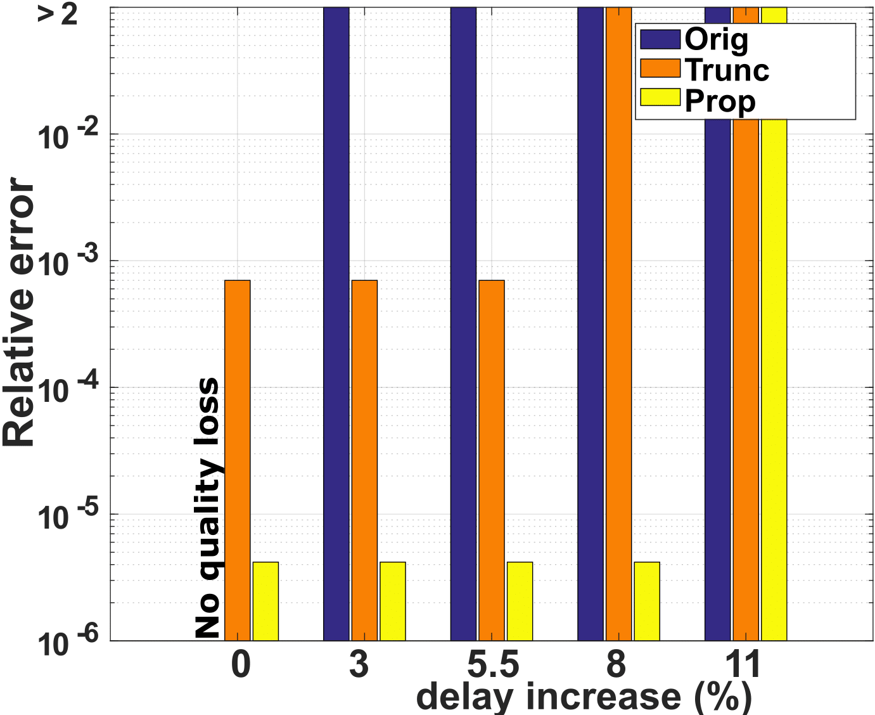
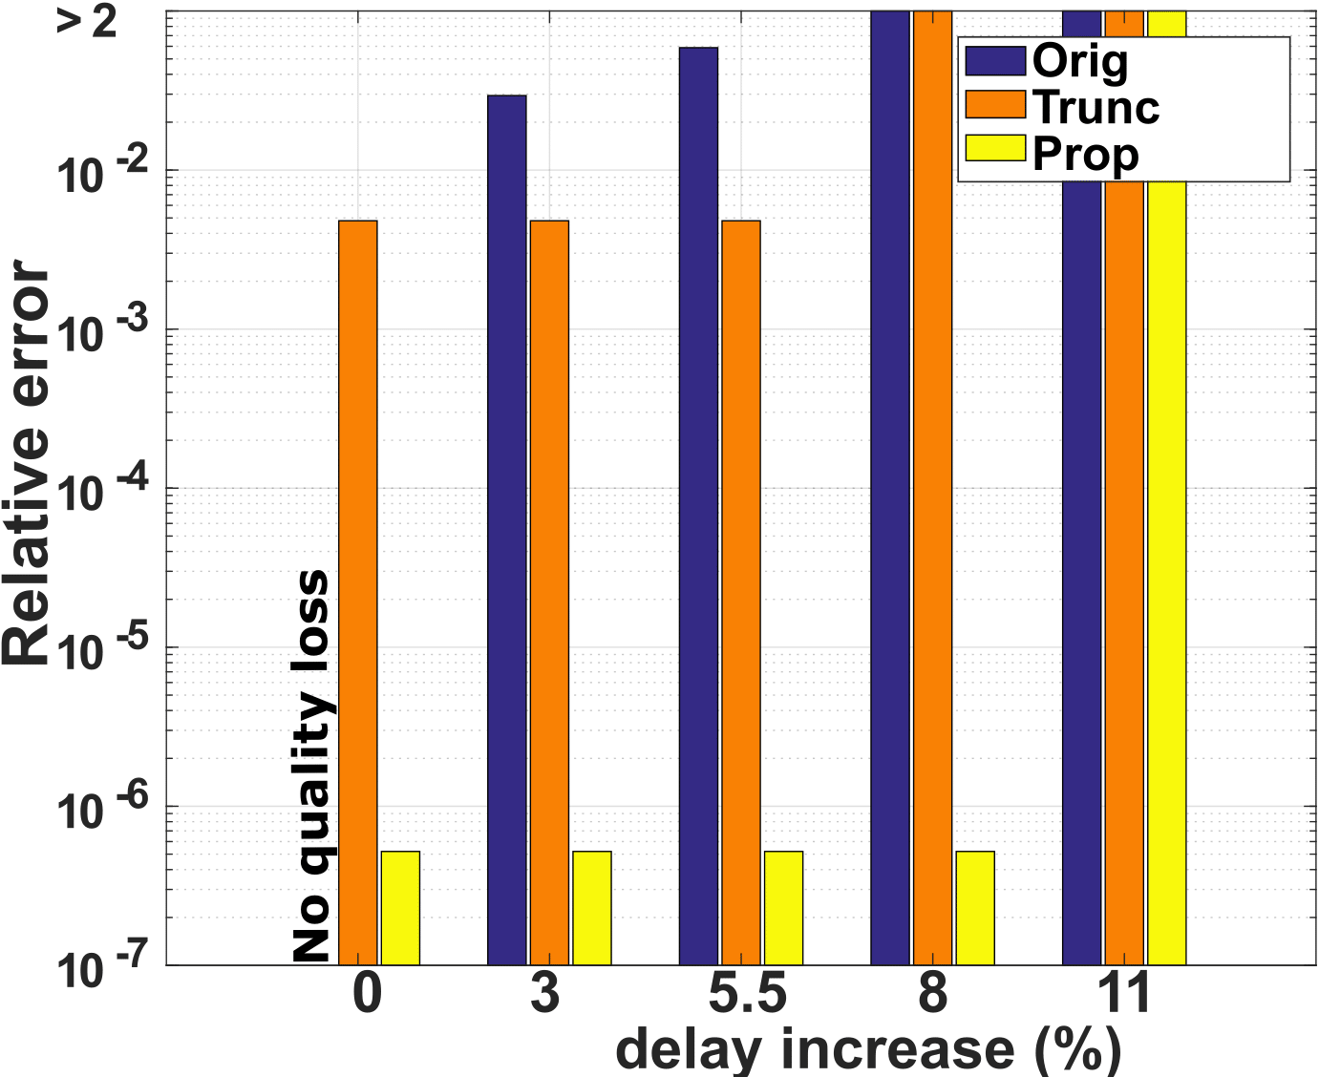
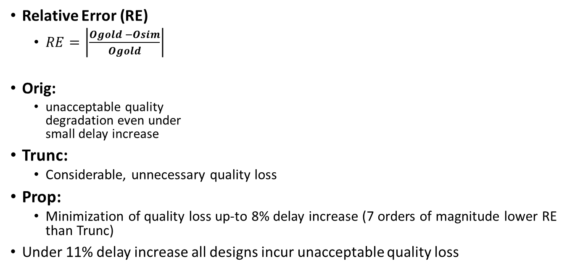
Evaluation Results – Quality loss
CFD
Raytrace
Relative Error (RE)
$RE=\left|\frac{Ogold −Osim}{Ogold}\right|$
Orig:
unacceptable quality degradation even under small delay increase
Trunc:
Considerable, unnecessary quality loss
Prop:
Minimization of quality loss up-to 8% delay increase (7 orders of magnitude lower RE than Trunc)
Under 11% delay increase all designs incur unacceptable quality loss

Slide 19
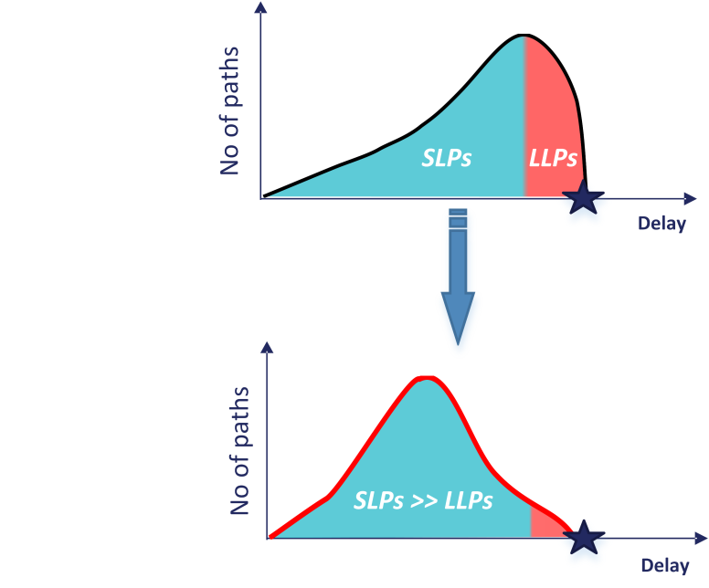
Area and Power Penalties
Integration of:
Path shaping technique
Long Latency Paths Prediction Unit
Area overhead: 0.34%
Power overhead: 4.48% on average
Area and Power Overheads

Slide 20
Comparison with a Guardband based scheme
Guardband based design: up-scale voltage to avoid failures
Fast corner cell library (1.25V)
Proposed design eliminate failures at lower voltage
Typical corner cell library (1.1V)
Applications |  | Power Gains in Prop vs Guardbands (%)
K-means |  | 41.73
Heartwall |  | 44.3
Raytrace |  | 38.76
CFD |  | 38.78

Slide 21
Conclusions
Framework for eliminating timing failures in pipelined cores by:
Detecting the excitation of the error-prone long latency paths.
Redesigning the target circuit in a way that isolate the LLPs in a single stage.
Dynamically truncating the bitwidth only of the operands that activate the isolated LLPs.
Up-to 44.3% power savings at 0.34% area overhead and minimal quality loss

